Slide 1
Capitalism
The dominant economic system in the world

Slide 2
Where is it?
Everywhere in the world!
Except Cuba, North Korea, and Venezuela.

Slide 3
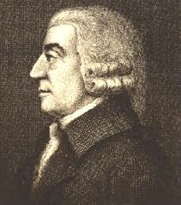
1. invention of capitalism
Adam Smith is an Englishman
Writes Wealth of Nations in 1776

Slide 4
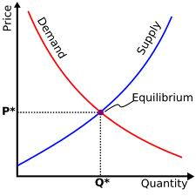
2. Free market
Price is determined by supply and demand.
If something is scarce, it costs more.
If something is in demand, it costs more.
If there is more of something than people want, it’s cheap.

Slide 5
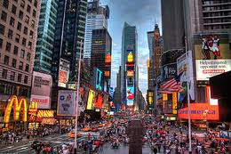
The invisible hand: the market regulates itself.
prices
amounts to manufacture
how much people will consume
who will sell what
Wages and what jobs people will have

Slide 6
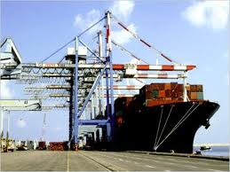
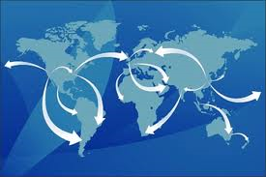
3. Free market
Countries should be as free as possible to trade.
Countries should not have to pay tariffs on imports and exports.
Comparative advantage
Each country should make what it’s best at.

Slide 7
4. Division of labor
People and countries will do what they are best at.
People are paid according to demand for their labor.

Slide 8
5. laissez-faire
Means “to leave alone” in French.
Government should be involved as little as possible in the economy.

Slide 9
6. social structure
Larger range between rich and poor.
People are limited by their talents and opportunities, as John Locke predicted.
Since people can invest their extra money, the rich get richer.

