Slide 1
Causes of the First World War

Slide 2
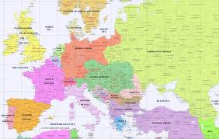
I. The World in 1914
The world is dominated by the major European powers.

Slide 3
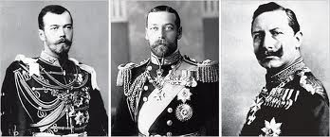
A. The Importance of Monarchy
Every country, except France, has a monarch as head of state.
Some have more power (Germany & Russia) and some have less (Britain)
King George V, Tsar Nicholas II, and Kaiser Wilhelm II are first cousins

Slide 4
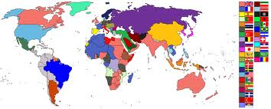
B. The Importance of Imperialism
Unless you are in China or Latin America, you live in country controlled by Britain, France, the Netherlands, Germany, or Russia.

Slide 5
C. Important Countries

Slide 6
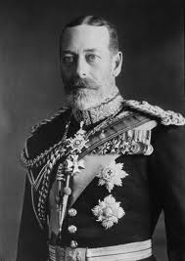
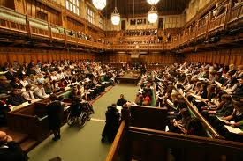
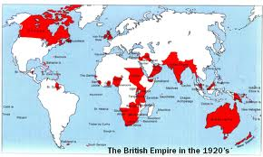
1. Great Britain
Government:
King George V is a national symbol
Parliament runs the country
Economy
A strong industrial economy
Empire:
¼ of humans are ruled by Britain
Empire includes India, NE + S Africa, Australia, and Canada

Slide 7
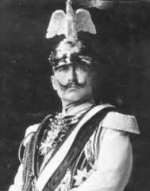
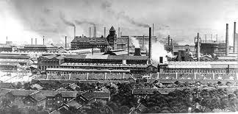
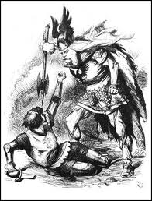
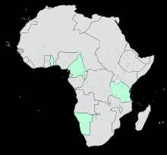
2. Germany
New country
unified in 1871
Government
Kaiser Wilhelm II has grabbed power.
Economy
A strong industrial economy
Military
Won several small wars in the 1800s
Empire
Small: Togo, Tanzania, + Namibia.

Slide 8
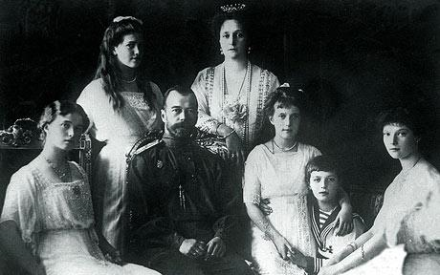
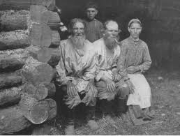
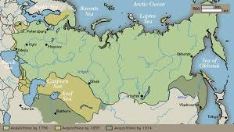
3. Russia
Government
Autocracy under Tsar Nicholas II
Economy
Agricultural; most Russians are still peasants
Constant strikes
Military
Lots of soldiers; few weapons
Empire
Huge, but poor in resources
All of central Asia

Slide 9
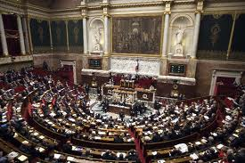
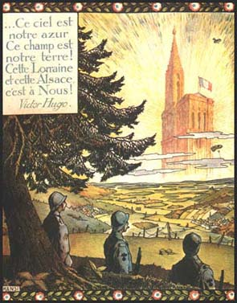
4. France
Government
Republic, with a Prime Minister
Economy
Not as strong as Britain and Germany
Concerns
Angry about loss of Alsace-Lorraine in the Franco-Prussian War
Tried to keep up with German Army after being invaded in 1870

Slide 10
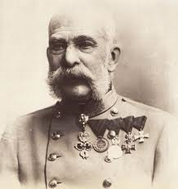
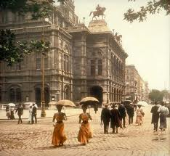
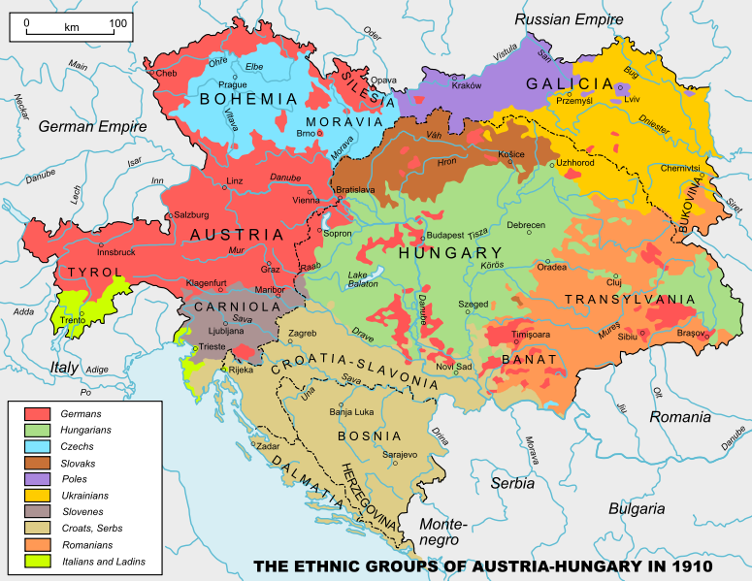
5. Austria-Hungary
New country
Unified 1867
Diversity
Over ten ethnic groups
All are second to Austrians
Government
Emperor Franz Josef
Two Parliaments

Slide 11
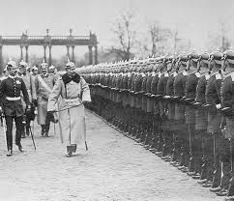
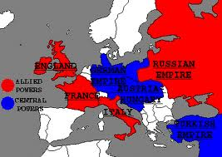
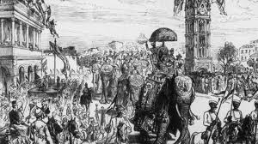
II. Causes
M: militarism
A: alliances
I: imperialism
N: nationalism

Slide 12
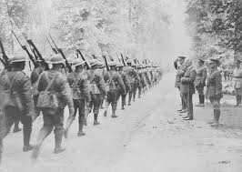
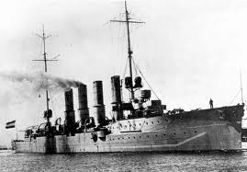
Militarism
The armies of France and Germany doubled in size between 1870 and 1914.
Britain and Germany competed for the largest navy.
Germany planned for a future war, developing the Schliffen Plan to defeat France.

Slide 13
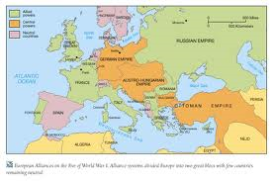
Alliances
Promised to go to war if any went to war
Allies (Triple Entente)
Britain
France
Russia
Central Powers (Triple Alliance)
Germany
Austria-Hungary
The Ottoman Empire (now Turkey)

Slide 14
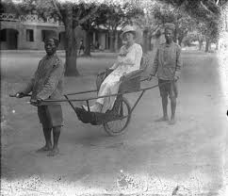
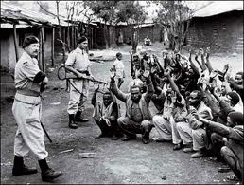
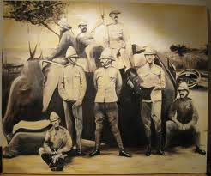
Imperialism
Britain and France had largest empires
Germany’s empire was small
Colonies provided
Raw materials
Markets for products

Slide 15
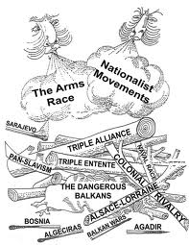
Nationalism
Everyone thinks their country is the best.
Germany is huge and new.
France is angry about Alsace-Lorraine

Slide 16
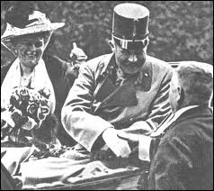
III. Assassination of Archduke Franz Ferdinand
Heir to the Austria-Hungarian throne killed in Sarajevo in Bosnia
Killer is 19-year-old Gavrilo Princip, a member of The Black Hand, who wants freedom for Bosnia
Austria-Hungary and Germany declare war on Serbia
Serbia has cultural ties and an alliance with Russia

