Slide 1
The End of the first World War
Germany loses

Slide 2
The Central Powers lose!
Allies (winners!)
Great Britain (includes soldiers throughout the British Empire)
France
Russia (left the war because of the Russian Revolution in 1917)
USA (one year)
Central Powers (losers!)
Germany
Austria-Hungary
The Ottoman Empire (now Turkey)

Slide 3
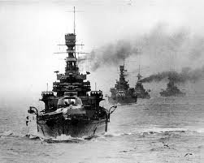
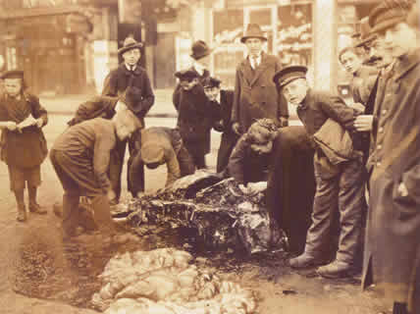
I. British Naval Blockade
The blockade cut off supplies from the German army and the German people.
The war lost support among the German people.

Slide 4
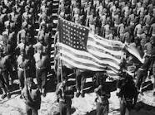
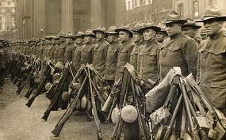
II. The U.S. enters the war
A. Importance
The US enters in 1917
The US had a huge army and lots of resources.
Soldiers were drafted
Americans had not been demoralized by years of fighting.

Slide 5
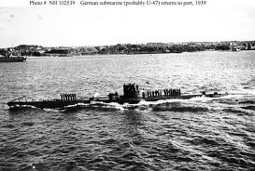
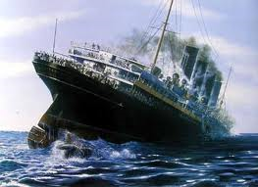
B. Why did the USA enter?
Submarine warfare
Americans were helping the Allies secretly
German U-Boats sink American ships.
Including the Lusitania, which had civilian passengers

Slide 6
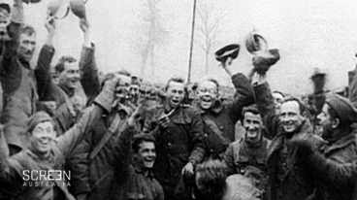
III. Armistice
The guns stop at 11:11 am on 11/11/1918
Today, this day is celebrated as Remembrance Day in Great Britain, Canada, etc.

Slide 7
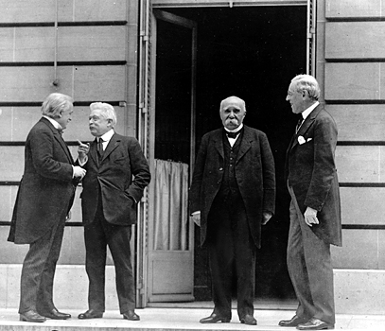
IV. Treaty of Versailles
Versailles
King Louis XIV’s palace outside of Paris
Where they wrote the treaty to end the First World War
The Treaty of Versailles
Made by Great Britain, France, and the USA;
Germany and Austria-Hungary NOT invited.

Slide 8
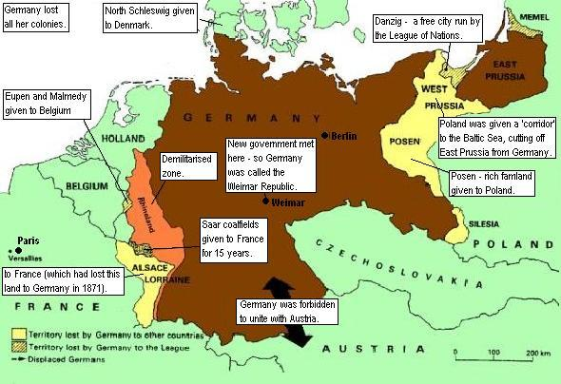
V. Harsh Conditions for Germany
Germany had to
Accept total responsibility for causing the war;
Pay 32 billion in reparations (“I’m sorry” money)
Get rid of their an army and navy
Germany lost
25 million sq. miles of territory and 7 million citizens
All their colonies in Africa (Cameroon, Namibia, Togo, Rwanda, and Burundi).

