Slide 1
LGBTQ rights
Lesbian, gay, bisexual, transgender, and queer rights

Slide 2
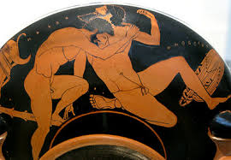
Ancient Greece
Certain expressions of male homosexuality are celebrated, especially pederasty, a mentoring relationship between older men and young men that had sexual elements, without full intercourse.
Male homosexuality was thought to improve military performance.
The celebrated poet Sappho was from the island of Lesbos, which is the genesis of the word Lesbian.

Slide 3
Medieval Europe
In 13th c. France, first-offending sodomites lost their testicles, second offenders lost their member, and third offenders were burned. Women caught in same-sex acts could be mutilated and executed as well.
Famous theologian Thomas Aquinas argues that sodomy is second only to murder in the ranking of sins.
King Henry VIII passes the Buggery Act 1533 making anal intercourse punishable by death throughout England

Slide 4
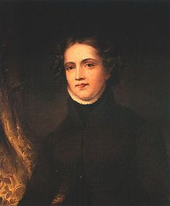
Starting the 1800s
Homosexuality is considered
A mental illness
Illegal (anti-sodomy laws)
Thought to be a sin in the three monotheistic religions
Anyone who chose to LGB had to live in secret

Slide 5
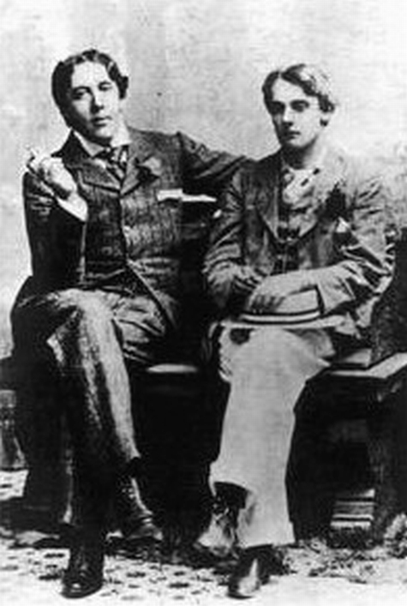
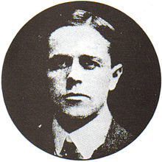
Homosexuality in 19th c. Britain
Cleveland Street Scandal
Police raided a male brothel, it was rumored that Prince Albert Victor, second in line to the British throne, was a patron.
Oscar Wilde, the famous playwright and author, was convicted of sodomy in 1895 and was sent to prison, where he died.
George Cecil Ives founds the first homosexual rights group in Britain, the Order of Chaeronea in 1897. However it is a strictly secret organization

Slide 6
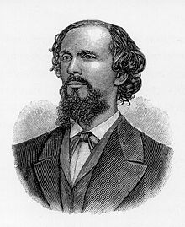
Karl Heinrich Ulrichs
German (1825-1895)
Published many books and essay about male homosexuality at first under a pseudonym
Later published Studies on the Riddle of Male-Male Love under his own name, which marks the first “coming out” of a European man.

Slide 7
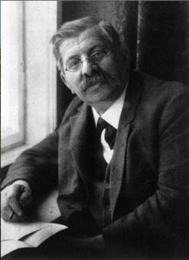
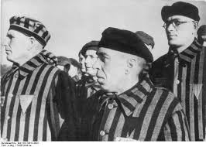
Magnus Hirschfeld
Lived in Germany, but forced to leave in 1933.
Hitler sent LGBT people to concentration camps, marking them with a pink triangle
Founded the Institut für Sexualwissenschaft (Institute for Sexual Research)
Argued for feminism and rights for homosexuals and transgender people
Funded the first film about homosexuals, “Different from Others.“

Slide 8
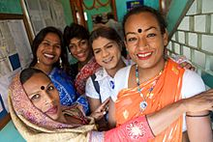
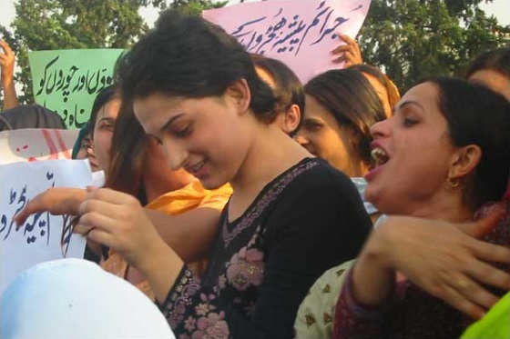
Hijra
No equivalent in Western understandings of sexuality
Considered a “third gender” by the governments of Pakistan (2009)and India (2009).
Although many are forced into sex work for survival, many renounce sexuality altogether.
Sexual energy is transformed into sacred powers.
Face lots of discrimination; Indian Supreme Court outlawed homosexuality in 2013.

Slide 9
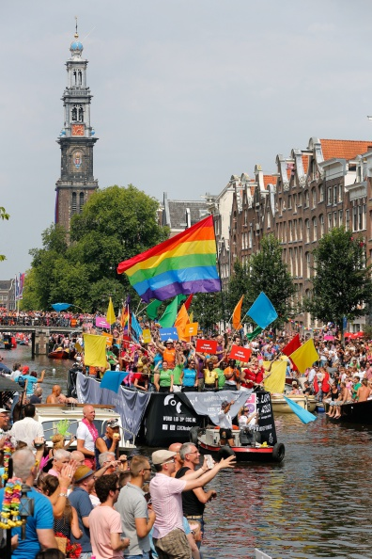
Modern LGBT organizations
1946 – "COC" (Dutch acronym for "Center for Culture and Recreation"), one of the earliest homophile organizations, is founded in the Netherlands.
1950 –Swedish Federation for Lesbian, Gay, Bisexual and Transgender Rights (RFSL), is formed in Sweden;
1950 – The Mattachine Society, the first sustained American homosexual group, is founded in Los Angeles, California

Slide 10
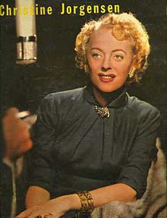
Christine Jorgensen
born in the Bronx
was a soldier in WWII
Transitions to being a woman through a series of operations in Copenhagen, Denmark
Is an activist for transgender rights.

Slide 11
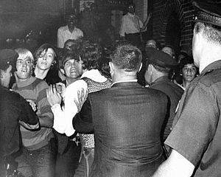
Stonewall Riots
In Greenwich Village in 1969
There was routine raid on a gay bar.
Crowds formed on the street and threw things at the cops.
When the cops pushed back, the crowds mocked and sang.

Slide 12
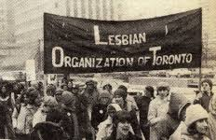
Canada
Canada March 1964 marches for homosexual rights, included men in drag, protests outside Canadian Parliament
Decriminalizes homosexuality in 1969
Pierre Trudeau, the Canadian Prime Minister is quoted as having said: "The state has no place in the bedrooms of the nation."

Slide 13
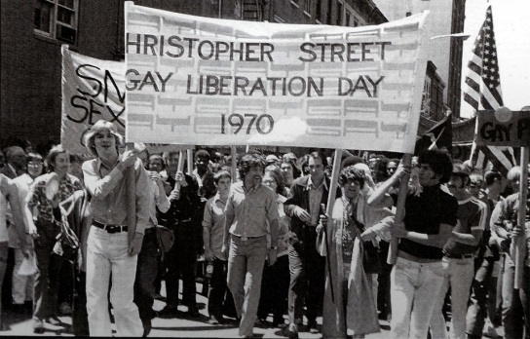
1970s
1970 – First Gay Pride Parade is held in New York.
1972 – Sweden becomes first country in the world to allow transsexuals to legally change their sex, and provides free hormone therapy
1973 –the Australian and New Zealand College of Psychiatry Federal Council declares homosexuality not an illness

Slide 14
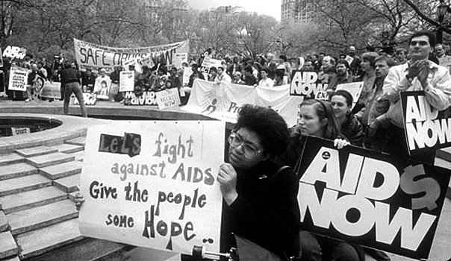
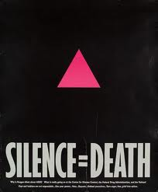
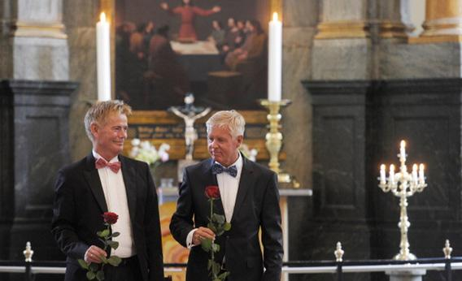
1980s
The AIDS crisis drives activism throughout the world
By 1989 in the USA, 117,508 cases of AIDS reported
89,343 deaths
1989: Denmark becomes the first country to recognize same-sex marriage; Norway and Sweden follow.

Slide 15
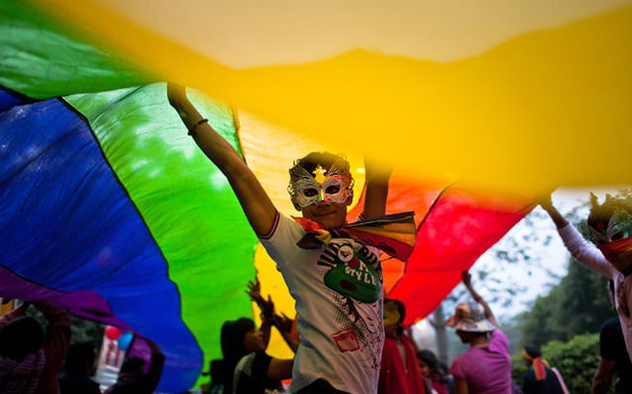
2000s
Many Western countries:
Announce homosexuality is not an illness
Decriminalize homosexual sex
Pass anti-discrimination laws
LGBT people grow visible in the media and in popular culture

