Slide 1
Events during the Russian Revolution
1917

Slide 2
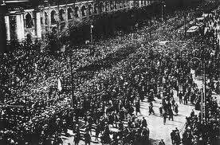
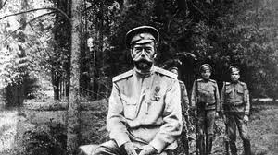
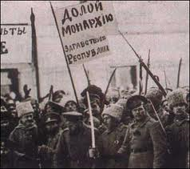
I. Revolution of February1917
Women workers go on strike, when they realize there is no bread to buy.
Men join them on strike
Cossacks refuse to attack the striking workers.
Army begins a mutiny
The train carrying Tsar Nicholas II is stopped by revolutionaries. Tsar Nicholas II abdicates the throne, ending the Russian monarchy

Slide 3
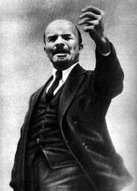
II. Revolution of November 1917
Lenin is
Extremely smart
A great speaker
Promises the people peace, land, and bread!
Lenin grabs power by convincing the army to support the Bolsheviks.
The Red Guard storms the Winter Palace

Slide 4
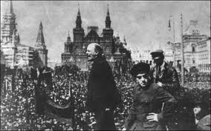
III. Lenin’s Russia
Treaty of Brest-Litovsk
Ends war with Germany
Russia loses Estonia, Latvia, Lithuania, Poland, and the Ukraine (27% of Russia’s farmland)
Communist reforms
Gives away land to peasants
Eight-hour work day and holidays
Unemployment insurance
Nationalizes banks and factories.
Limits free speech
Bans non-Bolshevik papers
Bans non-Communist political parties
Forms a secret police, the Cheka

Slide 5
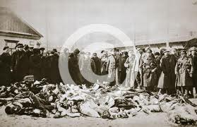
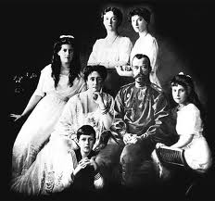
IV. Russian Civil War
Reds versus Whites
Reds (the Bolsheviks)
Whites
supported democracy or the Tsar
Supported by Great Britain, France and the USA
Thousands killed – civilians and soldiers
Killed Tsar Nicholas II and his family

Slide 6
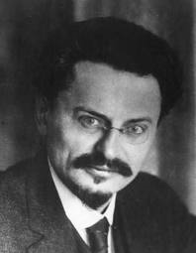
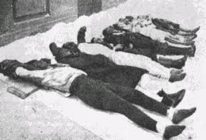
V. The Red Terror
Led by the Cheka and Leon Trotsky
Tortured people to extract confessions
In the countryside, burned, hanged beat, shot anyone who helped the Whites.
After a battalion ran from battle, Trotsky executed one of ten every ten soldiers by firing squad.
Red Army won by 1921

Slide 7
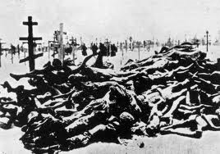
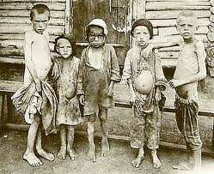
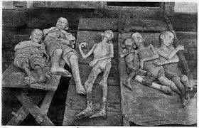
VI. Famine
Communism is implemented
All factories are nationalized
Death penalty for strikes
Private trading is banned
Money is devalued; inflation is encouraged
Food is rationed and controlled by the government.
Terrible famine (1921)
Peasants stop growing food
7 million people die
N.E.P. (New Economic Plan)
developed by Lenin
stops famine
is more capitalist

Slide 8
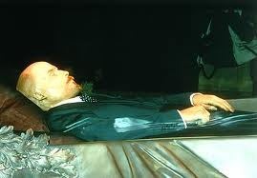
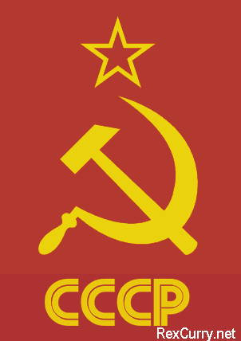
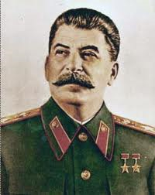
VII. Creation of the Soviet Union (U.S.S.R.)
Vladimir Lenin dies in 1924
Joseph Stalin takes power until 1953
New constitution (1923) declares the Union of Soviet Socialist Republics (U.S.S.R.)
The world’s first communist country
The world’s first command economy

