Slide 1
The Industrial Revolution in Britain
beginning of the modern world
1750s-1830s

Slide 2
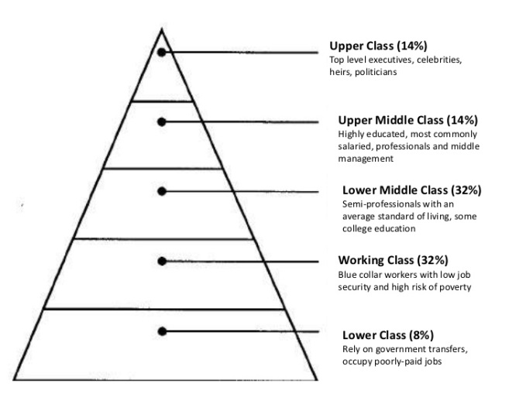
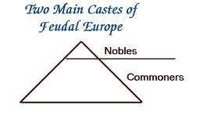
I. Why is this important?
Everything we own was made in a factory; most of it in other countries.
Our socio-economic class structure dates from the Industrial Revolution

Slide 3
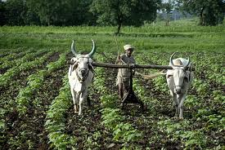
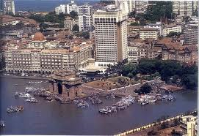
The United States, Japan, and Europe are post-industrial service economies.
50% of people live in suburbs
People work in service jobs
Only 10% work in factories
Other countries (like China and India) are having their industrial revolutions.

Slide 4
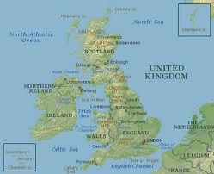
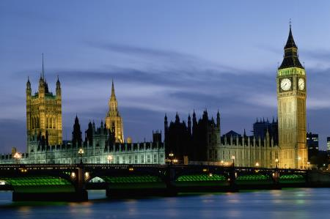
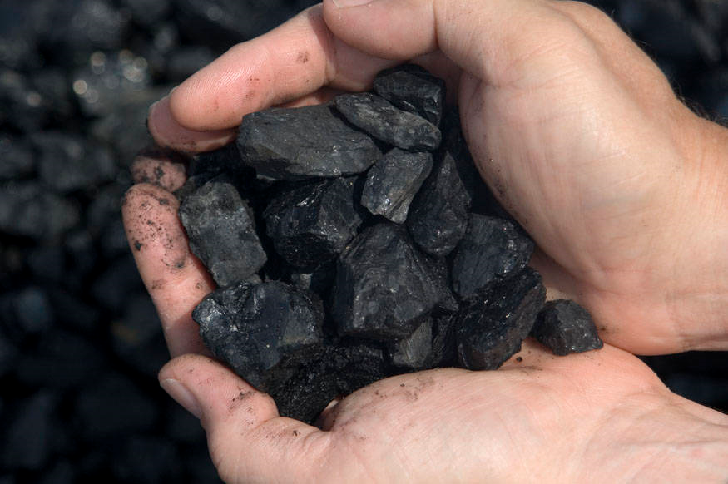
II. Why England?
England is a island; isolated from wars during the 1700s.
England’s limited monarchy and Parliament gave citizens rights.
England has many rivers, coal, and iron.
People had capital to invest.

Slide 5
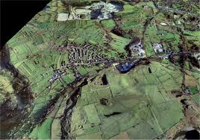
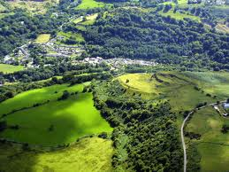
III. The Agricultural Revolution
Enclosure: making bigger fields out of small fields
New crops like potatoes and turnips.
More food = increased population

Slide 6
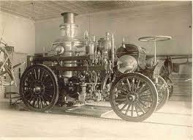
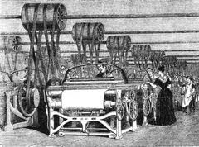
IV. New Inventions
Steam engine, invented by James Watt in 1782, provides power.
Spinning jenny, increases thread.
Flying shuttle for looms.

Slide 7
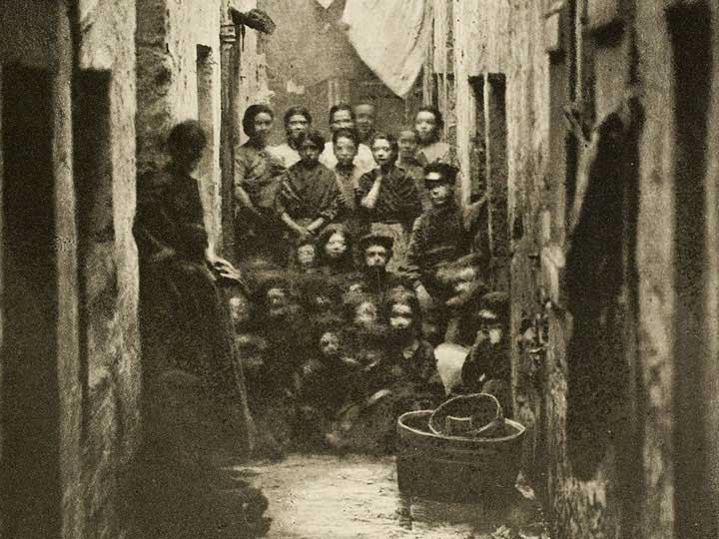
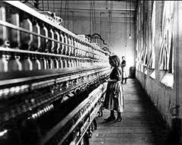
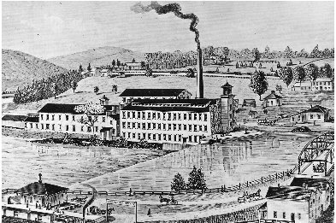
V. New jobs and houses
People work in factories, making cloth (textiles).
People move to cities, like Manchester, Birmingham and Newcastle (urbanization).

Slide 8
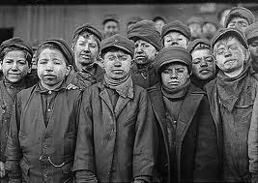
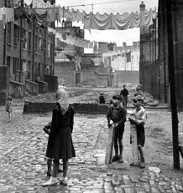
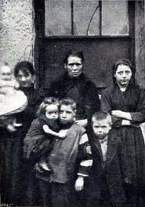
First slums for workers.
Child labor became common.
Women enter the work force.
Working16 hours for 6 days.
Over 50% of Britons live in cities.

Slide 9
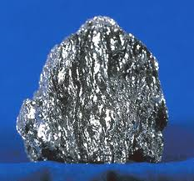
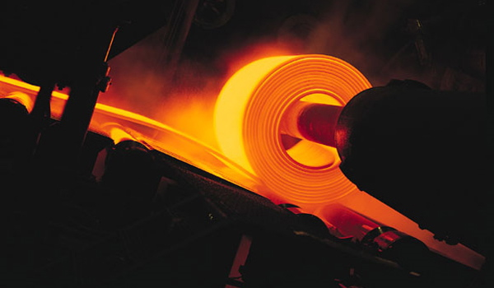
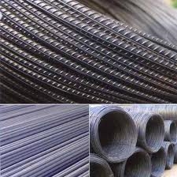
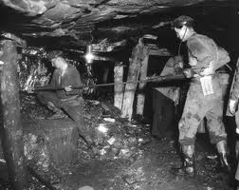
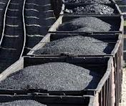
VI. Natural Resources
Iron used to make steel.
Coal becomes the source of power

Slide 10
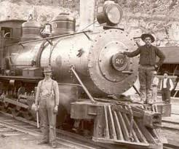
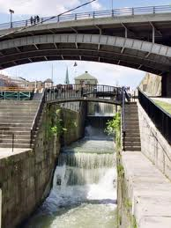
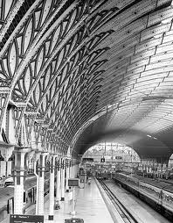
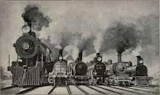
VII. Transportation
Canals
Railroads
Better ships

Slide 11
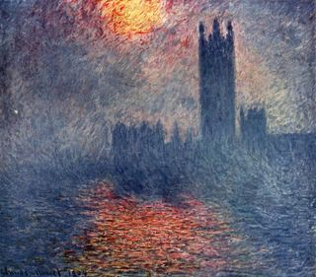
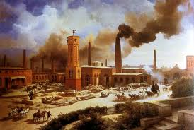
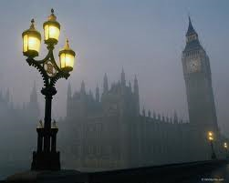
VIII. Pollution
Air pollution
Water pollution
Climate change (a.k.a. global warming)

