Slide 1
The Reign of Terror
The radical phase of Revolution

Slide 2
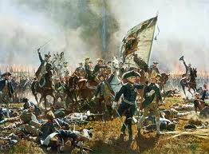
After Louis XVI and Marie Antoinette are executed . . .
Other European kings and queens are angry.
Austria, Prussia, Spain, Portugal, Britain, and the Dutch were about to invade France.
The French still have no money

Slide 3
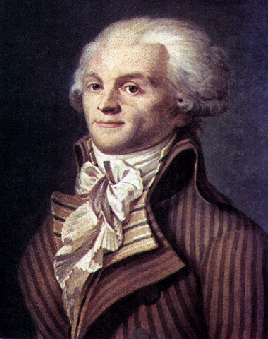
The Committee of Public Safety takes over
Robespierre is its head
Armies of sans-culottes rob peasants to feed the cities.
Drafted men into the army.

Slide 4
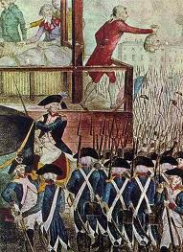
Their idea:
If you kill all the enemies of the Revolution, you will make a better France: a Republic of Virtue
40,000 people are killed without trial

Slide 5
Most people killed were members of the Third Estate
Over 90% of the people killed were bourgeoisie and peasants
The revolution was intended to take privileges away from the 1st and 2nd Estates and give them to the 3rd.

Slide 6
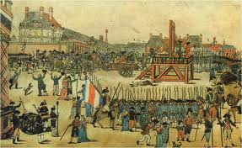
The end
Robespierre’s death, by guillotine, ends the Reign of Terror.

