Slide 1
The French Revolution
Stage 2: Ideals and less violence
1789-92

Slide 2
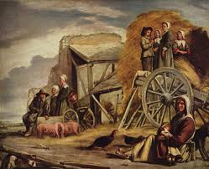
I. the French economy fails
Bad weather and floods destroy crops
Extremely cold winter
Price of bread is out of the reach of most people.

Slide 3
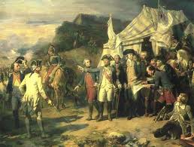
Huge war debts.
Less tax revenue coming in.
France can no longer borrow money.
government shuts down!!!!

Slide 4
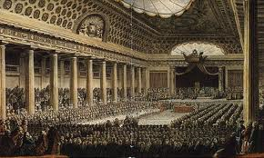
II. Estates-General
Louis XVI is forced to call its first meeting in over 175 years.
Voting by estate, even though there are many more people in the Third Estate
Can’t come to an agreement

Slide 5
an unfair voting system
Estate | Population | number of votes in E-G
1st: Clergy | 13,500 people | 1
2nd: the Nobles | 38,500 people | 1
3rd: bourgeoisie and peasants | 28 million people | 1

Slide 6
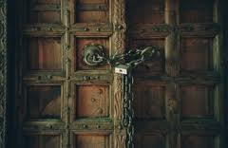
III. Oath of the Tennis Court
The First and Second Estate representatives lock the Third Estate out of the Estates-General

Slide 7
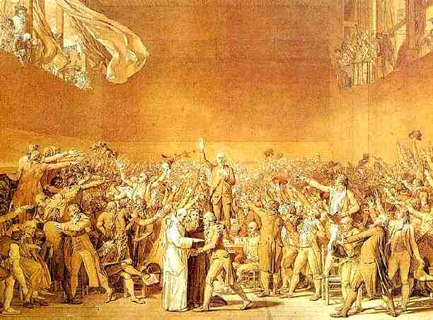
The 3rd Estate representatives swear the Oath of the Tennis Court
Form a new legislature: the National Assembly
Swear to write a new constitution

Slide 8
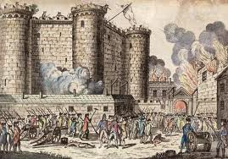
IV. Storming the Bastille
The price of bread had risen so much that people were furious
Peasants attack the king’s political prison and armory in Paris.
The army fires on the peasants

Slide 9
the Revolution has begun!
Liberté! Egalité! Fraternité!
Liberty! Equality! Brotherhood!

Slide 10
V. The National Assembly
Writes the Declaration of the Rights of Man
Writes a new constitution with a limited monarchy

Slide 11
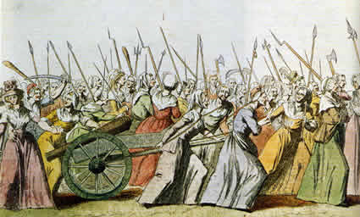
VI. Women’s March to Versailles
7,000 desperate women march 12 miles to Versailles
They carry two noblemen’s heads on pikes
They capture the King & Queen as prisoners, and take them back to Paris

