Slide 1
DEMOCRATIC SOCIALISM
A gentler form of communism

Slide 2
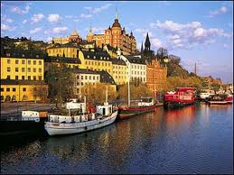
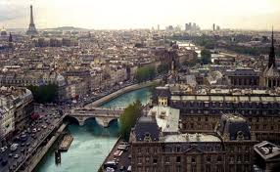
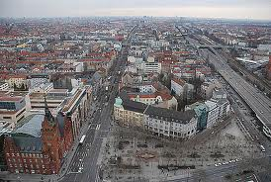
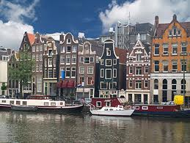
1. Where is it?
In every wealthy European country
Denmark
Norway
Sweden
Finland
The United Kingdom
The Netherlands
Switzerland
Germany
France

Slide 3
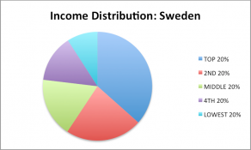
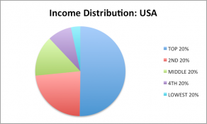
2. The big idea
Combines capitalism, democracy, and socialism.
Voting looks the same as a democracy
Tries to redistribute wealth more equally, so the rich and poor aren’t so far apart
Trusts government to provide quality services.

Slide 4
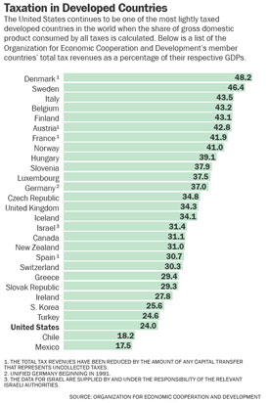
3. The Welfare State (in Sweden)
High taxes
Anyone making over $45,000 will pay 50-60% income tax
The richest cannot be that rich (the richest Swede has half the wealth of the richest American)
Unemployed people
the government pays $2,400-$1,110 a month
Old people
have high pensions and full healthcare

Slide 5
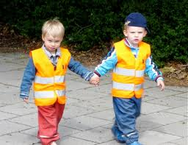
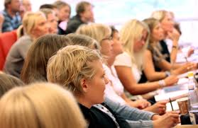
Children
Free daycare from birth
14 months of paid leave from work for having children
Education
Free from kindergarten to graduate school
Stipend ($) for students

Slide 6
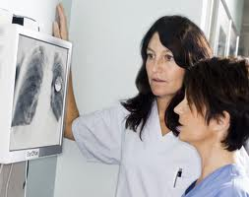
Healthcare
Free
Provided by government

Slide 7
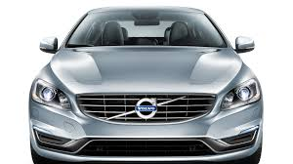
4. Everything else
Sweden has big companies, like the USA
Everything else is done by the market.
Sweden’s economy does not grow as fast as USA
Sweden does not have as many new companies as the USA.

