Slide 1
Feminism
A movement in three waves

Slide 2
vocabulary
feminism: A belief in the social, political, and economic equality of men and women
male chauvinist or sexist: someone who believes men are better than women
Patriarchy: a male dominated society

Slide 3
American Influence
Many of the most famous feminists are American women.
Gloria Steinem
Betty Freidan
bell hooks
Elizabeth Cady Stanton
Susan B. Anthony
Alice Paul
Although feminism has been adapted to other contexts, it began an upper-middle class, white movement.

Slide 4
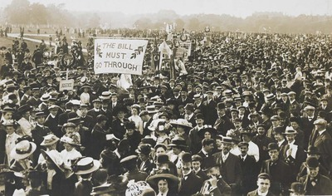
First wave feminism 1860s-1910s
Goals:
Abolishing coverture, which is the idea a woman's legal rights and obligations were subsumed by those of her husband
no inheritance, it goes to the husband
no custody over children, it goes to the husband
no right to keep their wages; wages belong to the husband
Suffrage, which is the right to vote.

Slide 5
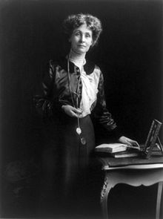
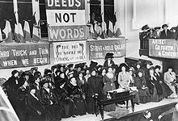
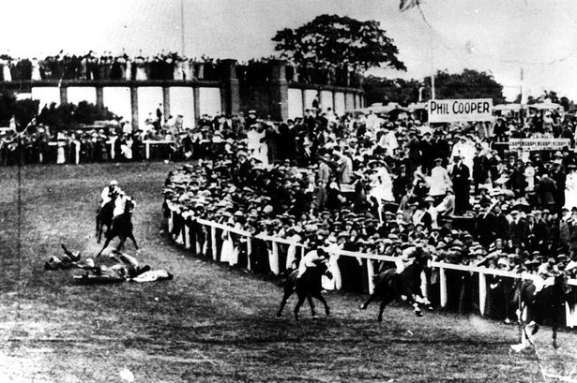
Famous British first wave feminists
The Women's Social and Political Union (WSPU)
Used violence; slogan was “Deeds not words”
Emmeline Pankhurst is the founder
Arrested several times
Hunger strikes
Bombed Westminster Abbey
Emily Davison threw herself in front of the King’s horse and died.
Bombed the home of David Lloyd George, the Chancellor of Exchequer.
Smashed windows of shops, churches, and government offices
Mary Richardson slashed a famous painting in the National Gallery

Slide 6
universal women’s suffrage
1902: Australia (except for aboriginal women)
1906: Finland
1915: Denmark
1917: Azerbaijan, Armenia, Belarus, Estonia, Latvia, Lithuania, Poland, Russia, Uruguay.
1918: Canada, Germany, the United Kingdom
1919: the Netherlands and New Zealand
1920s: Albania, Czechoslovakia, Ireland, Spain (only single women and widows), Mongolia, Uruguay, Ecuador, Sweden, USA
1930s: South Africa (only white women), Turkey, Chile, Portugal, Sri Lanka, Thailand, Brazil, Cuba, Philippines, Bolivia, Bulgaria (only mothers), Romania, El Salvador
1940s: Panama, Dominican Republic, Jamaica, France, Italy, Japan, Senegal, Togo, Indonesia, Cameroon, Djibouti, Guatemala, Kenya, North Korea, Liberia (Americo women only; indigenous men and women were not enfranchised until 1951), Venezuela, Vietnam, Argentina, China, Costa Rica, Syria
1997-2015: Kuwait, Qatar, , Oman, and Saudi Arabia

Slide 7
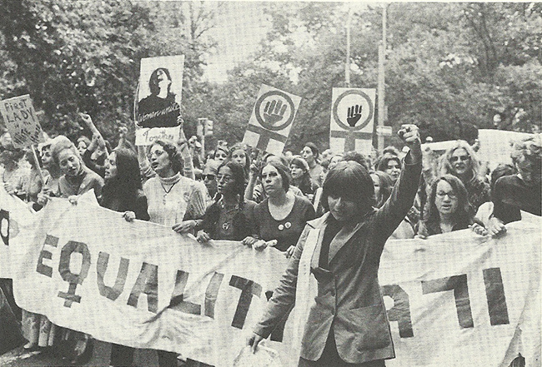
Second wave feminism 1960s-1970s
Goals:
Expand job opportunities for women
More women working outside of the home
More women outside of the “feminized professions”: nursing, teaching, or secretarial work.
Access to birth control
Equal pay
Equal representation in government
Equality in the arts and sports
Equal rights in marriage
The use of Ms. instead of Miss and Mrs. to help end discrimination based on marital status

Slide 8
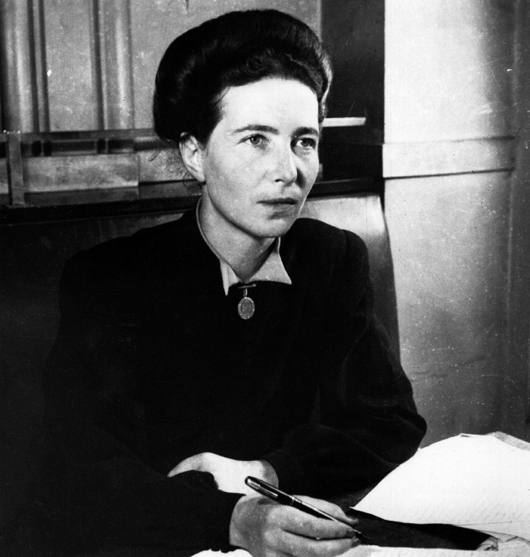
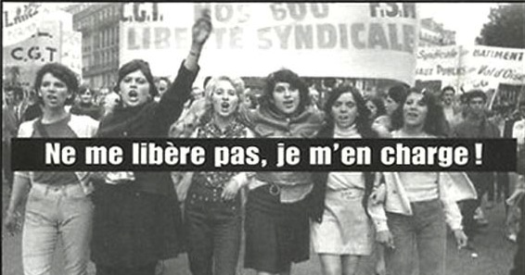
Famous French second wave feminists
Simone de Beauvoir
Wrote The Second Sex
Refused to marry her lover, the famous philosopher, Jean-Paul Sartre
Wrote the text for the Manifesto of the 343 Bitches (le manifeste des 343 salopes), which was signed by 343 women who admitted to having abortions (illegal at the time)
Women's Liberation Movement (MLF)
Protested during the student protests of 1968.

Slide 9
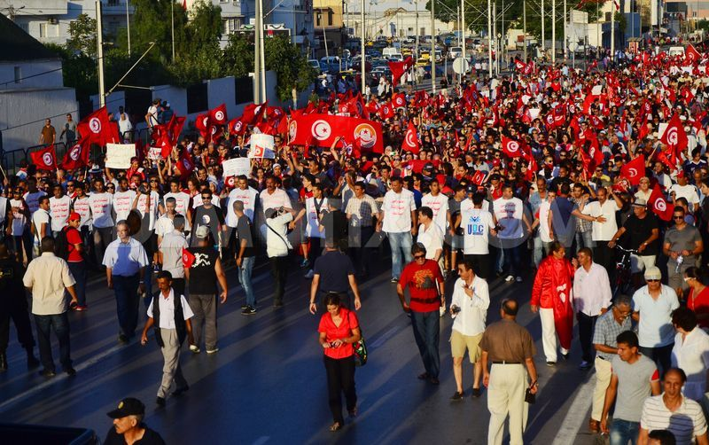
Third wave feminism 1990s to now
Goals
Incorporates the concerns of queer, working class women, and women of color.
Combatting stereotypes
Deconstructing gender roles
Promoting sex positivity
Supporting rights of sex workers

Slide 10
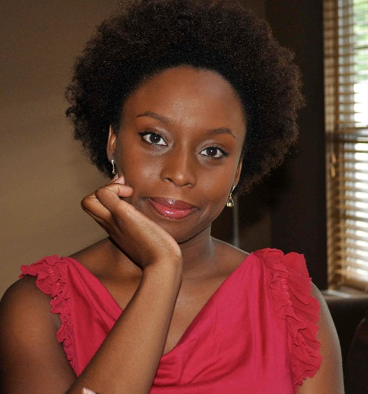
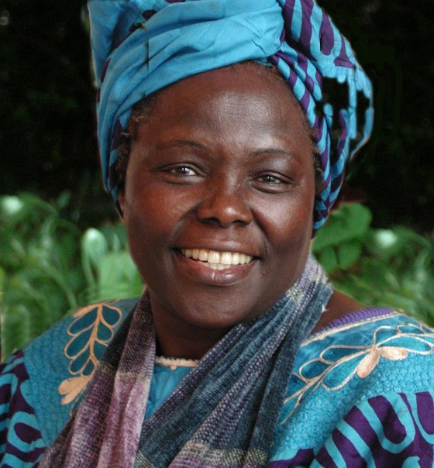
Famous Third Wave Feminists
Chimamanda Ngozi Adichie
Nigerian author
Wrote several novels (Americanah is my favorite)
Wrote “We Should All Be Feminists”
Wangari Maathai
Kenyan environmentalist
Won the Nobel Prize in 2004
Her Green Belt Movement planted tens of millions of trees.
She joined the struggle against the corrupt regime of Daniel arap Moi. Her efforts to stop powerful politicians grabbing land.
She was beaten and arrested numerous times.

Slide 11
More Third Wave
Malala Yousafzai
From Pakistan
Was shot by the Taliban for going to school
Youngest person to ever win the Nobel Prize
Wrote book and speaks all over the world about education for girls.
Advocates for girls going to school
In the developing world, only 50% of girls go to school.

