Slide 1
Four Political Revolutions
American, French, Haitian, and Latin American

Slide 2
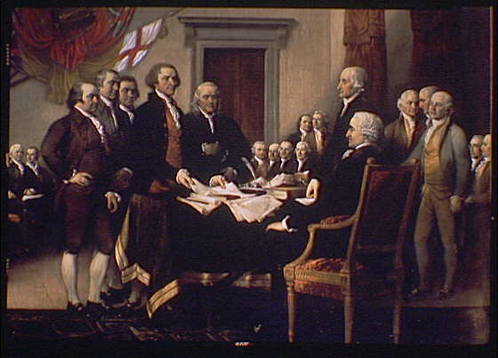
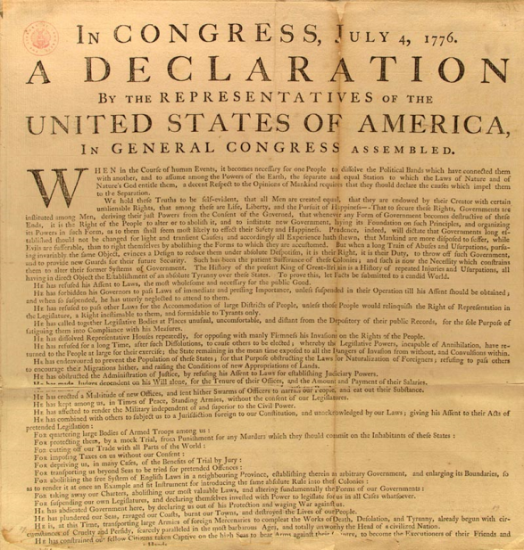
1. The American Revolution
The American colonies declare their independence from Britain with the Declaration of Independence in 1776.
The Declaration is based on Enlightenment values, especially the ideas of John Locke.
Political and economic power remains in the hands of wealthy, white men.

Slide 3
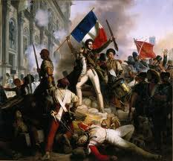
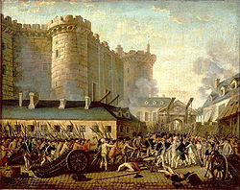
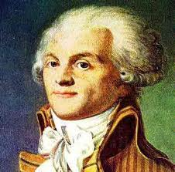
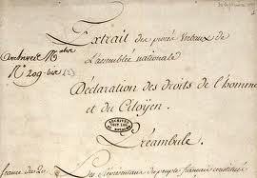
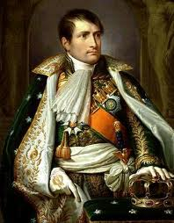
2. The French Revolution
The Storming of the Bastille and Oath of the Tennis Court establish a new government.
The new National Assembly writes the Declaration of Rights of Man in 1789.
Execution of King Louis XVI
Reign of Terror 1792-1794.
Napoleon becomes emperor in 1804.

Slide 4
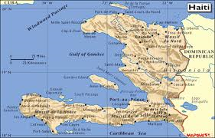
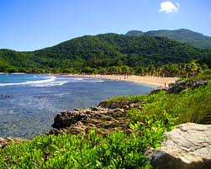
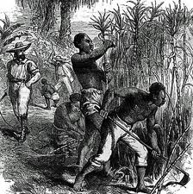
3. The Haitian Revolution
A. Background
Haiti is in the Caribbean.
The rich soil of Haiti made to produce one product: sugar.
Because sugar is new and popular, Haiti is France’s richest colony.

Slide 5
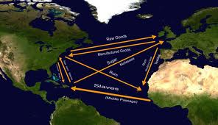
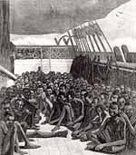
B. Slavery in Haiti
Slaves came to Haiti via the Middle Passage.
Slave owners found it easier to replace slaves than to treat them well.
On Haiti, there were:
500,000 African slaves, most of them recently brought from Africa
20,000 whites
30,000 free blacks and mulattos

Slide 6
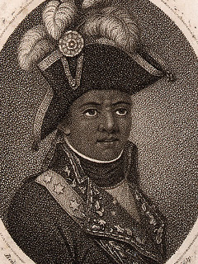
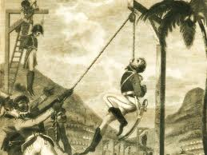
C. Revolution
The French Revolution leads to chaos in Haiti.
Enlightenment ideas spread in Haiti.
The leader of the revolution in Toussaint L’Ouverture
Freed from slavery when he was 33.
Was a servant and was taught and encouraged to read.
Later owned a plantation and slaves himself.
Toussaint’s army of slaves and maroons fights a bloody war with France, Spain, Britain, white, mulatto, free black Haitians loyal to France.

Slide 7
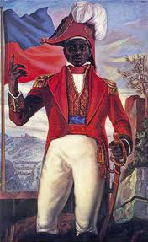
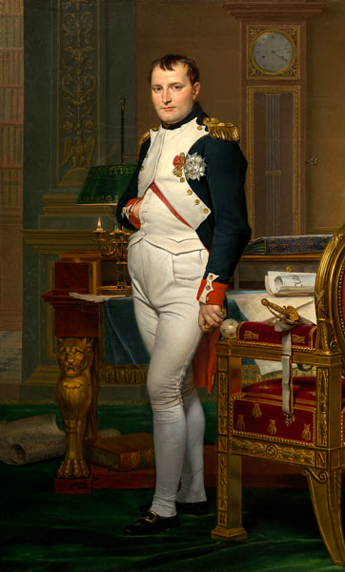
D. Independence
Haitians write a constitution, which outlaws slavery.
Toussaint L’Ouverture beats Napoléon’s army.
Haiti becomes independent in 1804.
The United States does not see the similarity with Haiti; Thomas Jefferson calls Toussaint’s army “cannibals.”

Slide 8
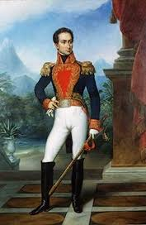
4. Latin American Revolutions
Simón Bolívar leads armies to overthrow Spain from 1819-1825.
Won independence for Bolivia, Panama, Colombia, Ecuador, Peru, and Venezuela.

Slide 9
5. The Result: Nationalism
pride in your country is called nationalism

