Slide 1
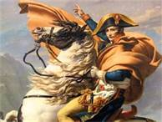
Napoleon Bonaparte
Emperor of France
1804-1815

Slide 2
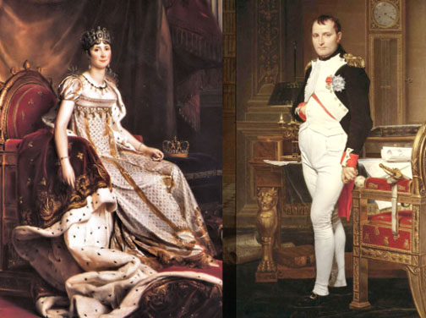
Fun facts
Was actually 5’7’’, an average height. Not short!
From Corsica, an island, and was teased for it.
Wrote a romantic novel based on his own life.
His first wife, Josephine, was brilliant and the fashion icon of her time.

Slide 3
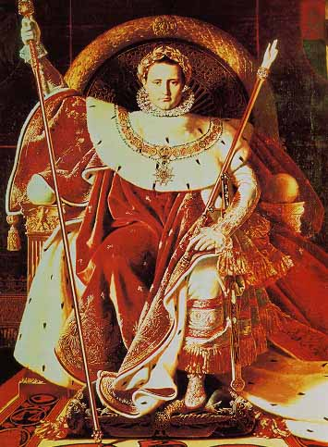
Napoleon comes to power
Napoleon is the top general in the French army.
France was a mess: still fighting wars with Austria, Russia, and Britain and no real government in Paris.
In 1799, Napoleon seized power in a coup d’état.
In 1804, Napoleon crowns himself emperor.
-

Slide 4
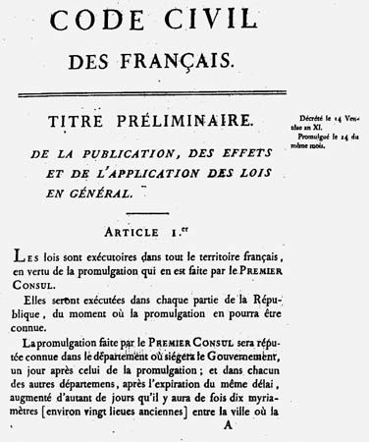
Changes under Napoleon
Tax collection made more fair.
started a public schools for ordinary citizens.
Created a central bank to stabilize the economy.
Wrote a new set of laws called the Napoleonic Code giving all French citizens the same rights.
Gave land back to the Church

Slide 5
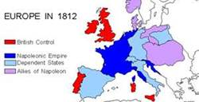
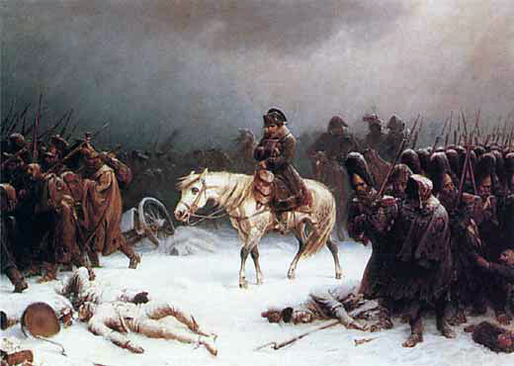
Napoleonic Wars (1805-1815)
One of the most successful military leaders of all history.
Could not beat Britain’s navy; lost the Battle of Trafalgar; decided NOT to invade Britain.
By 1807, Napoleon controlled most of Europe.
Lost his army in Russia to the winter.
Entered with 400,000 men and left with 40,000.

Slide 6
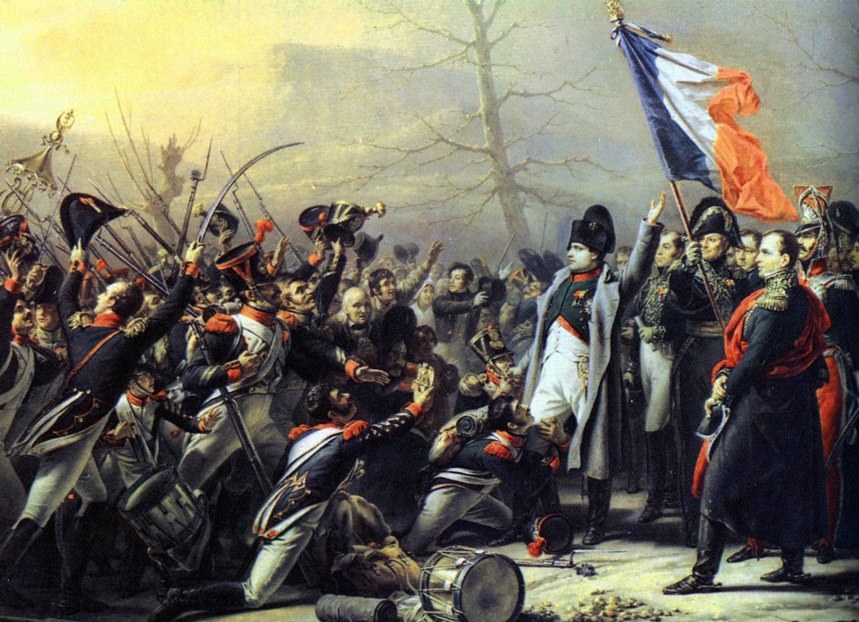
His second reign
The allies fight back and invade Paris in 1814.
After his defeat he is exiled to the island of Elba.
He escaped in 1815, returned to France and raised a new army.
Defeated in the Battle of Waterloo and exiled again.
The British put him in prison on the remote island of St. Helena, where he died in 1821.

Slide 7
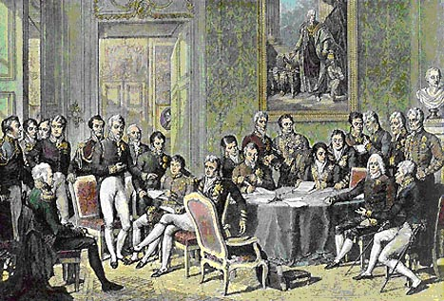
Congress of Vienna
Held in order to put Europe back together after Napoleon was defeated.
Lead by the Austrian statesman, Prince Klemens von Metternich
Designed Europe to maintain a balance of power.
All countries are kind of equal
No more wars!!!
Except for the Crimean War and the Franco-Prussian War, Europe is peaceful until 1914.

